Slide 1
Measuring the Effectiveness of Word-Embeddings for Facet Completion Tasks
Master thesis by
Prem Kumar Tiwari
December 1, 2020
First Referee: Prof. Dr. Benno Stein
Second Referee: Prof. Dr. Andreas Jakoby
Supervisor: Tim Gollub

Slide 2

Table of Contents
01
Motivation
02
Challenges and Related Tasks
03
Dataset Preparation from WordNet
04
Effectiveness Evaluation
05
Developing Embeddings Model for Facet Generation Tasks
06
Conclusion

Slide 3
01 Motivation
Motivation
What is Facet Term Recommendation?
It is a process of suggesting entities which belong to same semantic concept. The relevance of facets depends upon the information needed by the users.
User Query: Erfurt Recommendation 1: Weimar, Jena. . . Recommendation 2: Berlin, Magdeburg, Munich. . . Recommendation 3: Eastbourne, Essen, Etah. . . | User Query: Erfurt, Weimar Recommendation: Eisenach, Jena. . .
Notes:
If the user wants lists of dogs, recommendation 1 . . .Insert another irrelevant recommendation Example: USE cities like Erfurt, Muich, stuttgart capital of states or cities starting with cities E, there are many possible facets When other cities are offered, may possible facets disappear (when more terms are, more clear facets semantic is)

Slide 4
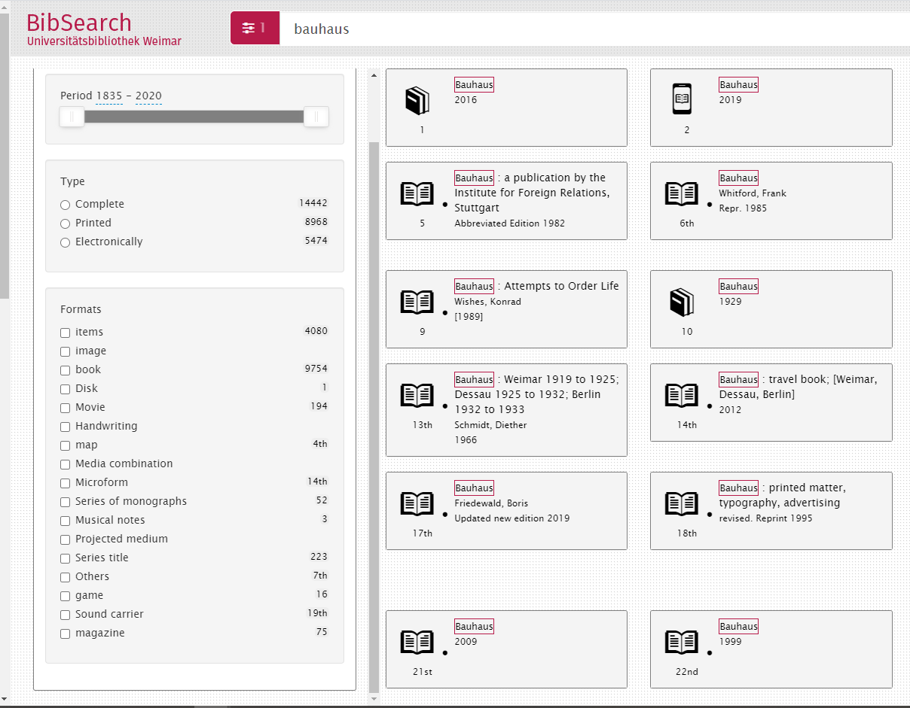
Why Do we need Facets?
Motivation
Use Cases:
Facets are used in Faceted Search System
https://bibsearch.uni-weimar.de/bauhaus/g=g1&fy=1835183520202020&fb=10002020&fd=local&fp=0&fs=0&ff=0
But users want different facets, e.g. Cities.
Notes:
With examples related to cities

Slide 5
02 Challenges and Related Tasks
Related Tasks
Feddoul, L. et al. [1] points out that manual predefinition is often inappropriate and, apt choosing among facets is virtually impossible without algorithmic support.
A pre-definition of all possible Facets is impossible, because users have many different and individual needs. Hence, the need for Algorithmic Support.
Existing Algorithmic support for Facet Term recommendation Tasks
Faceted Browsing over Knowledge graphs[2] but they are predefined static structures, i.e. don’t alleviate the problem of individual user needs.
So, how can we recommend?
Notes:
Make the text change to make more sense :)

Slide 6
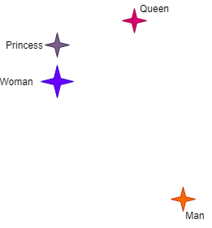
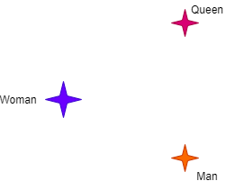
Why Word-Embeddings for Facet Term Recommendation Tasks?
Motivation
Word- Embeddings algorithm provide similar representation in a vector space for words that are similar to each other.
Through this we can navigate the vector space when word sense disambiguation increases and hence use the algorithmic support of word-embeddings for the tasks of facet term recommendation tasks.
Notes:
If Woman is a query word, then men and queen are potential candidate and King is further away. And this sense is captured in the word-embeddings models. More words for female royalty: Princess etc. If you start from single enity, like women: Men and queen are equally far from each other But when a second term is added to the query, then facet involving royal women move closer to each other then gender facet

Slide 7
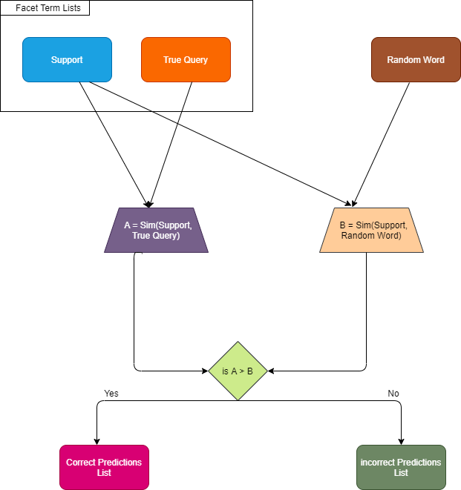
Now we would like to evaluate how word-embeddings performs on the task of Facet Term recommendations. For this we need a procedure and a dataset.
How we do it? We assess the cosine similarity among facets Terms and pit it against cosine similarity among random words.
We further analyze the similarity distribution among these Facet terms to understand the efficiency of word-embeddings model for this tasks.

Slide 8
DataSet Preparation
Dataset Challenges
For the purpose of understanding distribution of Facet Terms in the word-embeddings model, we shall create Facet from WordNet and then analyze the similarity distribution among the facet Terms of these Term Lists.
What is Facet?
It is one of the representation of knowledge structures. Term Lists(Facets) contains list of Facet Terms. We shall create Term Lists from another form of knowledge structures - Term Hierarchies- WordNet.
For the purpose of creating Facets from Wordnet, we shall only be working with ‘Nouns’ (POS).
Notes:
For the purpose focus on wordnet here,,accommodatethe vocab

Slide 9
03 Dataset Preparation from WordNet
Dataset Preparation
General Overview
This section is divided into two parts:
Extracting Facet Term Lists by Traversing WordNet.
From the Facet Term Lists, we generate Support-Query that can be fed to the evaluation procedure as shown in previous slide.

Slide 10
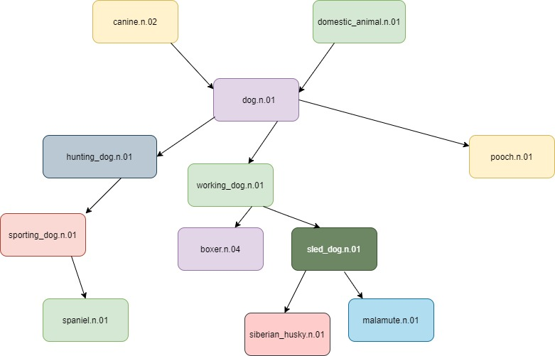
Structure of WordNet
Possible ways of Term Lists Generation
Direct Synset
Hypernym Traversal
Hyponym Traversal
Notes:
Be veru quick to state this: Skip them very fast. . .If you want to know more about it, we can ask this at end of the presentation

Slide 11
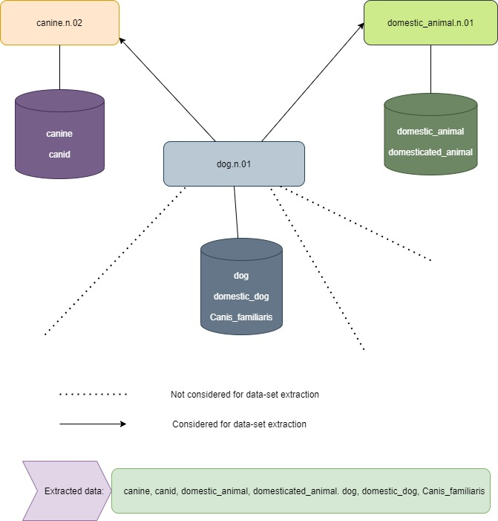
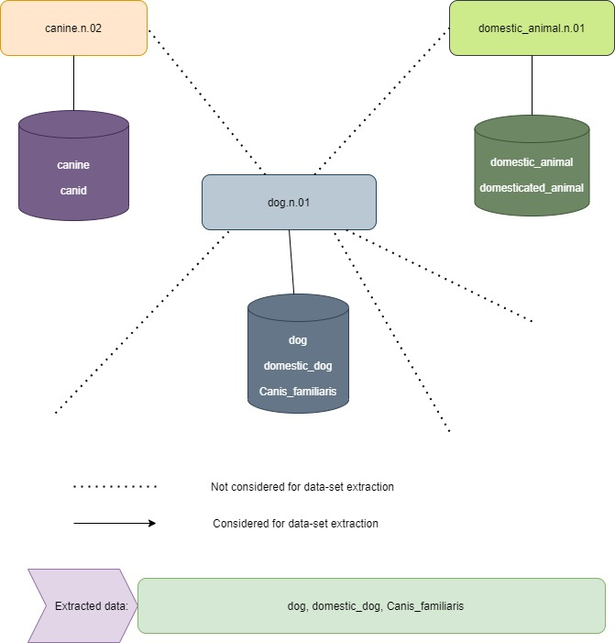
Term Lists Preparation Directly from Synset and Hypernymy Traversal
Term List Preparation
Direct Synset
Hypernymy Traversal

Slide 12
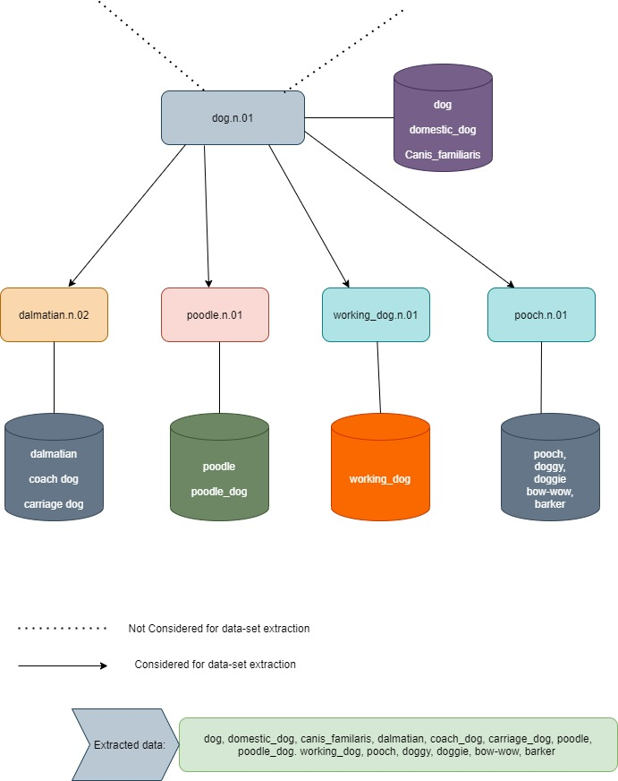
Term Lists Preparation through Hyponymy Traversal: Not Considered
Hyponymy Traversal

Slide 13
Support -
Query
Support - Query Generation
From the generated Term Lists, we generate our Support-Query pair.
Two Types
Single Support(X) and Single True Query(Y).
Multiple Support(X) and Single True Query(Y).

Slide 14
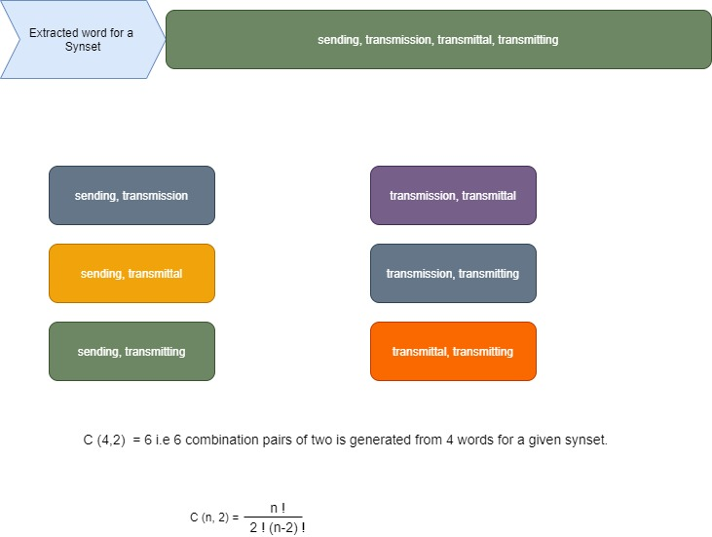
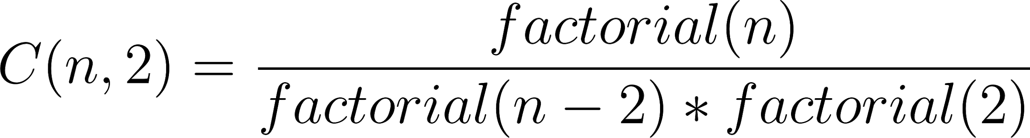
Single Support(X) and Single True Query(Y).
Support -
Query
For every Term Lists generated, we generate Support-Query as shown in diagram.
Type of WordNet Traversal | Number of (Support-Query)Pairs generated
Preparation from Direct Synset | 107469
Preparation from Hypernymy traversal of WordNet | 366712

Slide 15
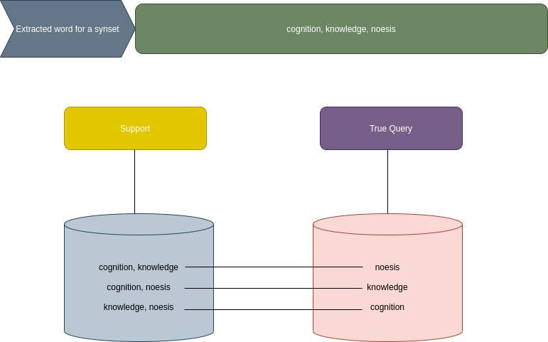
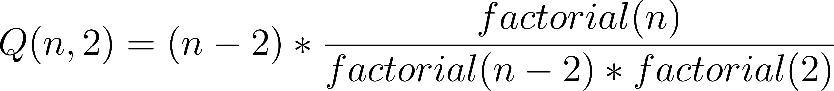
Multiple Support(X) and Single True Query(Y).
Support -
Query
For every Term Lists generated, we generate Support-Query as shown in diagram.
Type of WordNet Traversal | Number of (Multiple Support- Single Query) generated
Preparation from Direct Synset | 258408
Preparation from Hypernymy traversal of WordNet | 1380524

Slide 16
04 Effectiveness Evaluation
Evaluation Procedure
Two Types
Single Support(X) and Single True Query(Y).
Multiple Support(X) and Single True Query(Y).
We make comparisons for all the dataset prepared as shown in previous two pages according to procedure shown here.
Notes:
Make this slide at page 8. How can we determine the quality of an algorithm. What is the dataset and what are the numbers. Concering the dataset, one way is to get this facet term list, is to take the wordnet and the synset as a resource

Slide 17
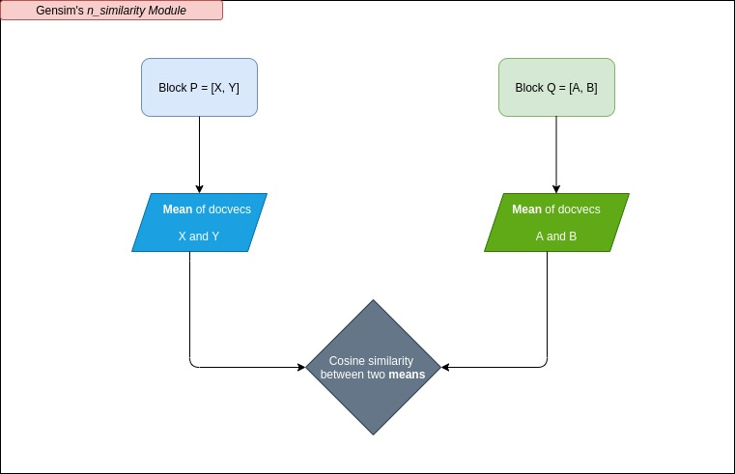
How is Similarity Calculated?
Block P gets Support (Single or Multiple) Block Q gets either True Query or Random word
After running the procedure, we take the similarity values and plot them for both correct and incorrect predictions. Their respective accuracy on the dataset prepared from WordNet is also shown in the figures that follow.
Notes:
Explain here correct and incorrect predictions

Slide 18
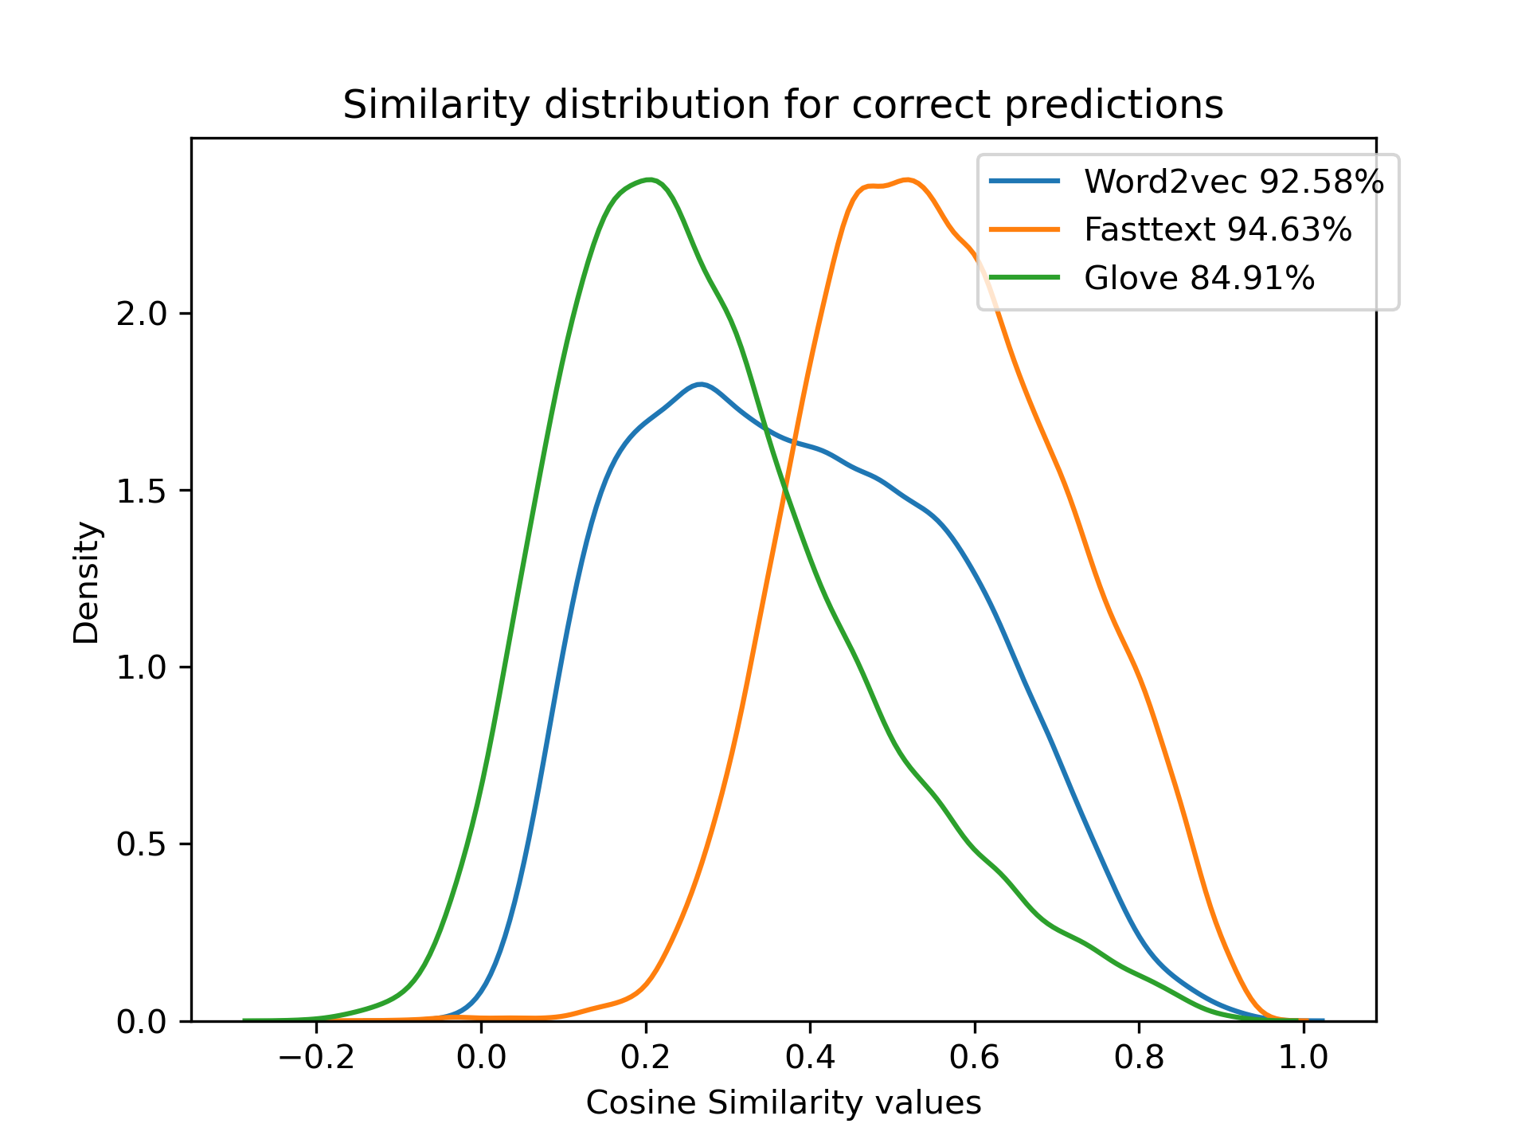
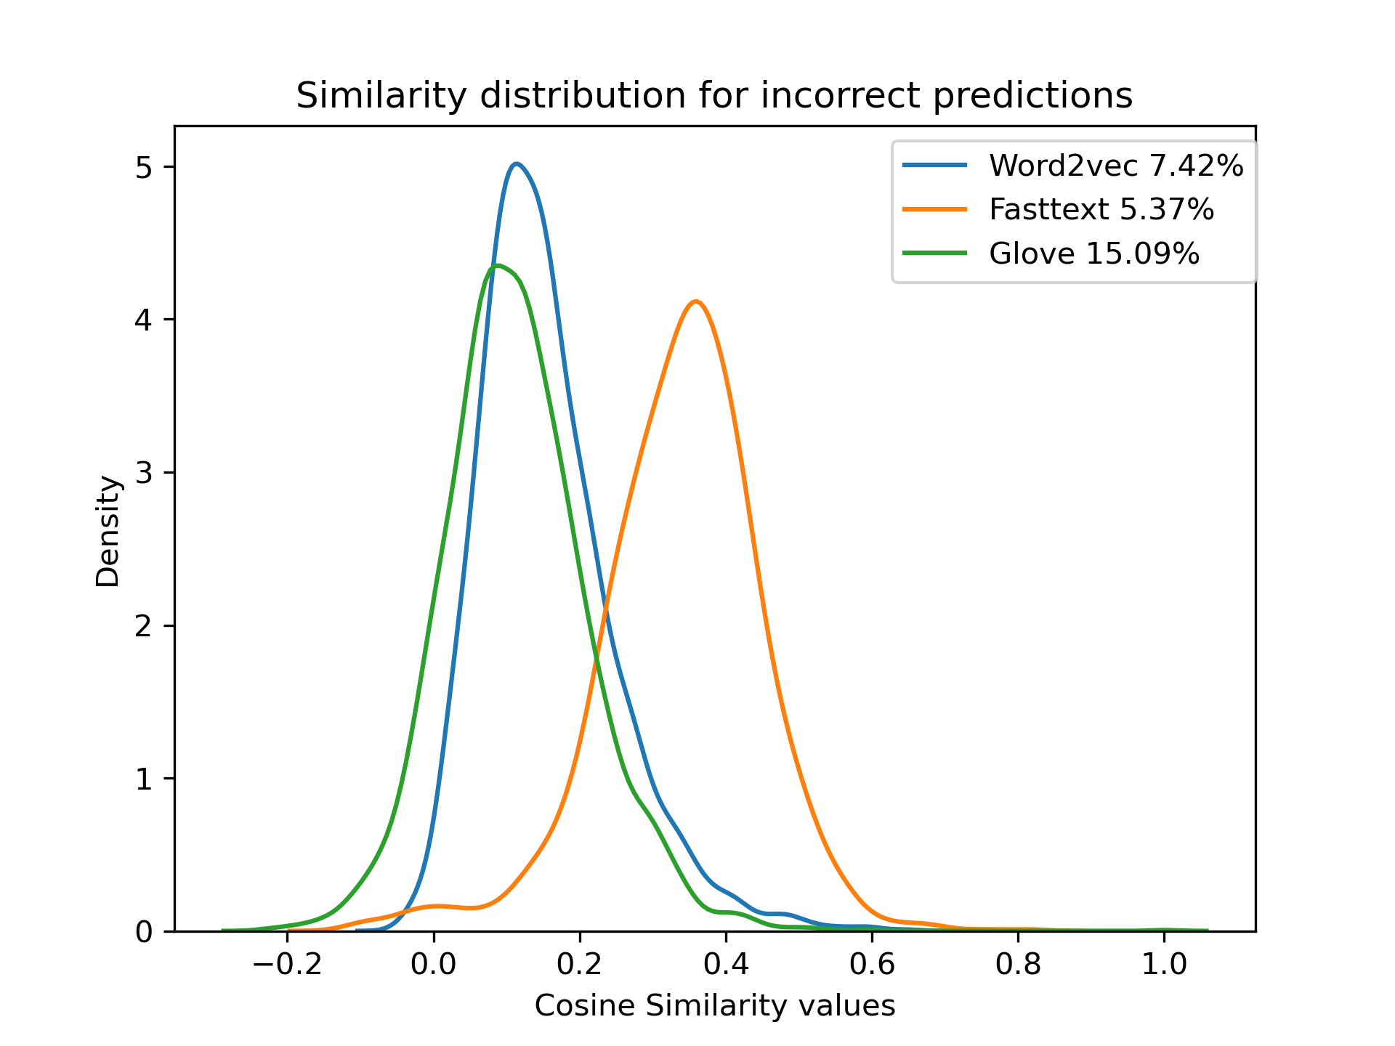
Single Support(X) and Single True Query(Y) for Direct Synset.
Direct Synset
RESULTS ANALYSIS

Slide 19
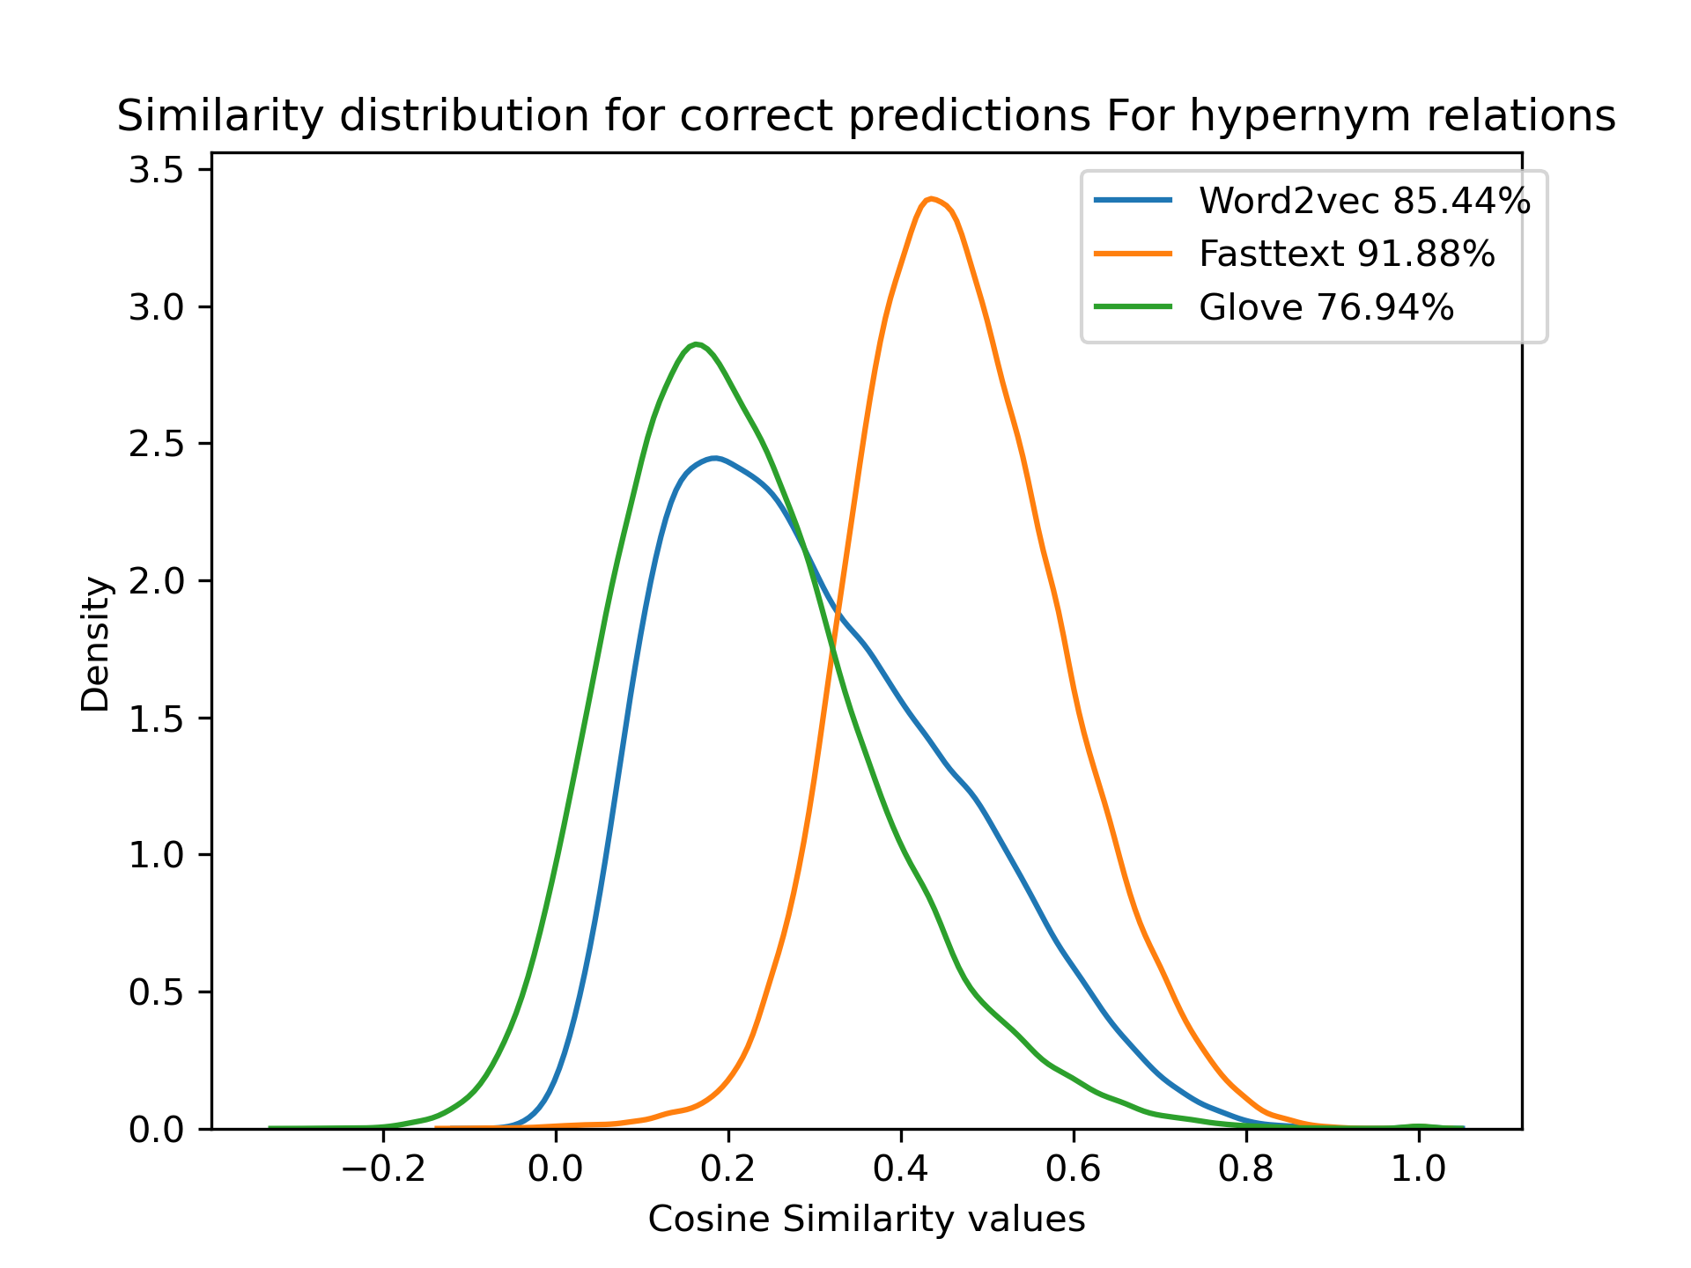
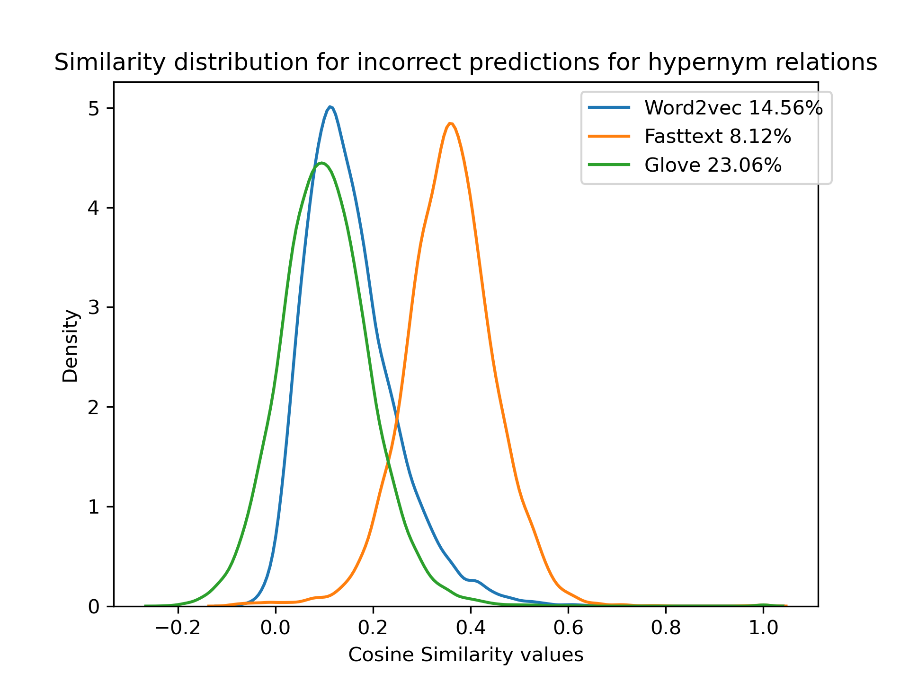
Single Support(X) and Single True Query(Y) for Hypernym Traversal.
Hypernym Traversal
RESULTS ANALYSIS

Slide 20
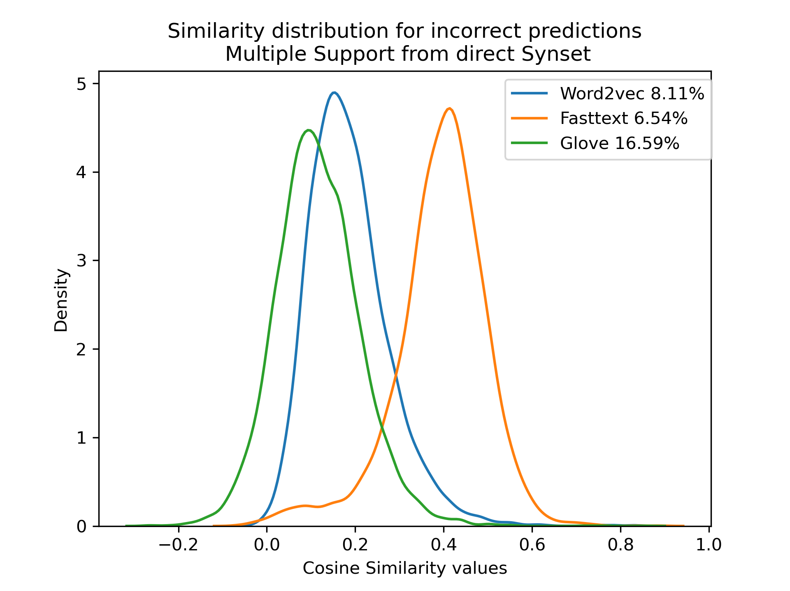
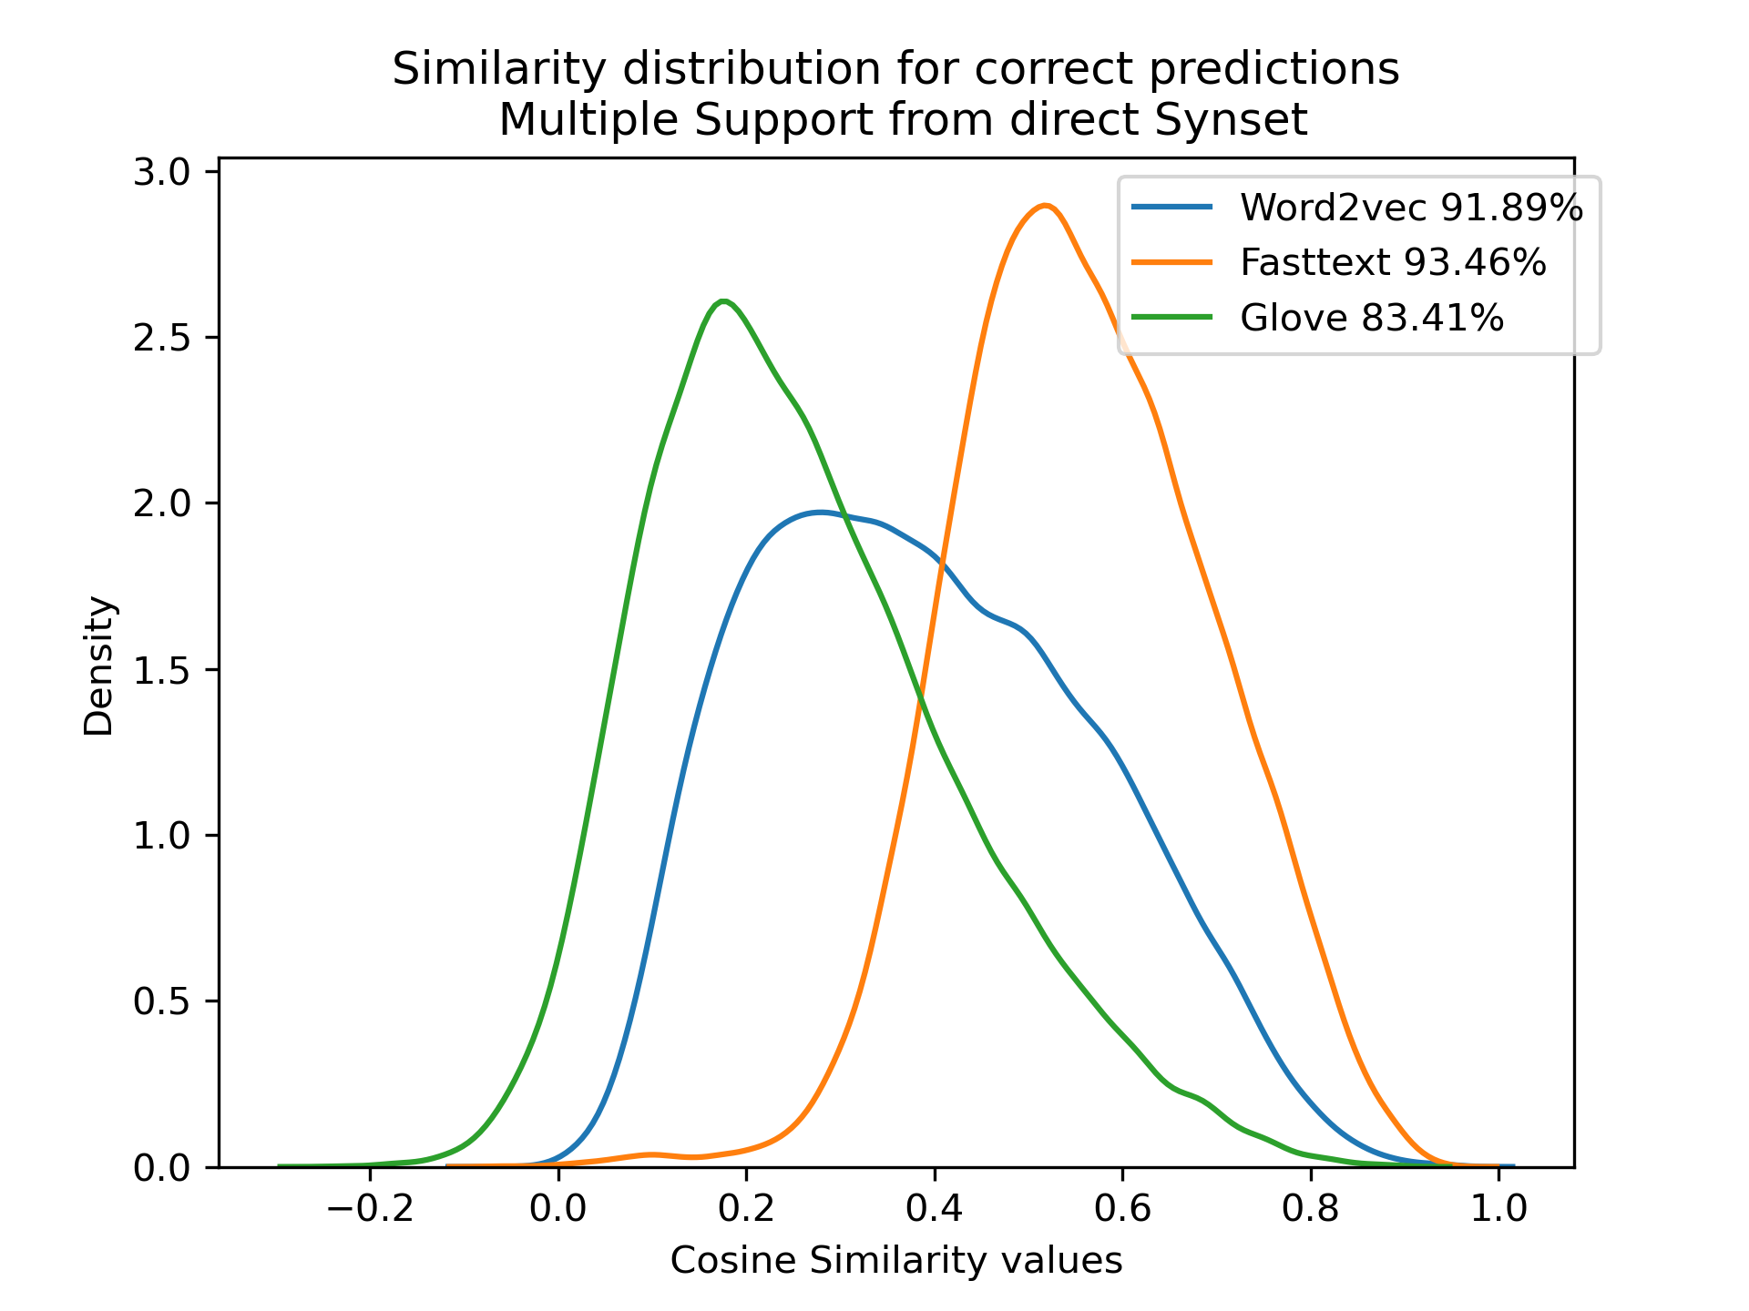
Multiple Support(X) and Single True Query(Y) for Direct Synset.
Direct Synset
RESULTS ANALYSIS

Slide 21
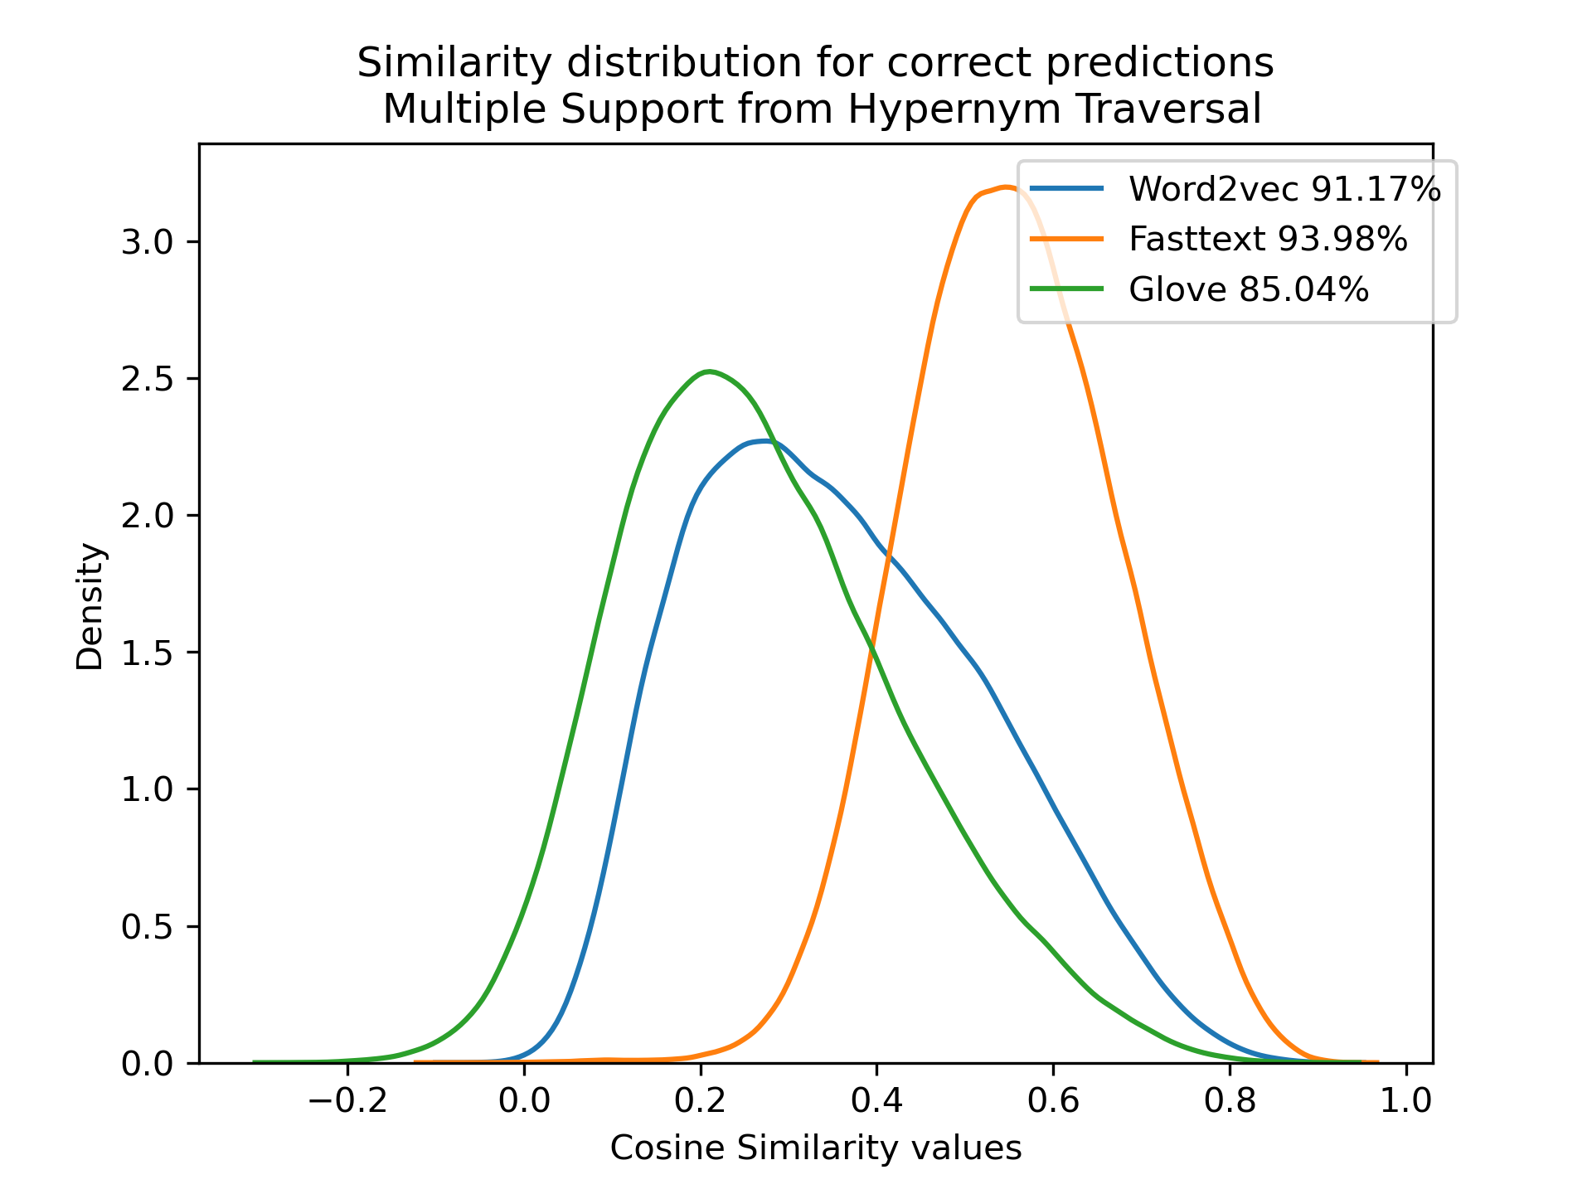
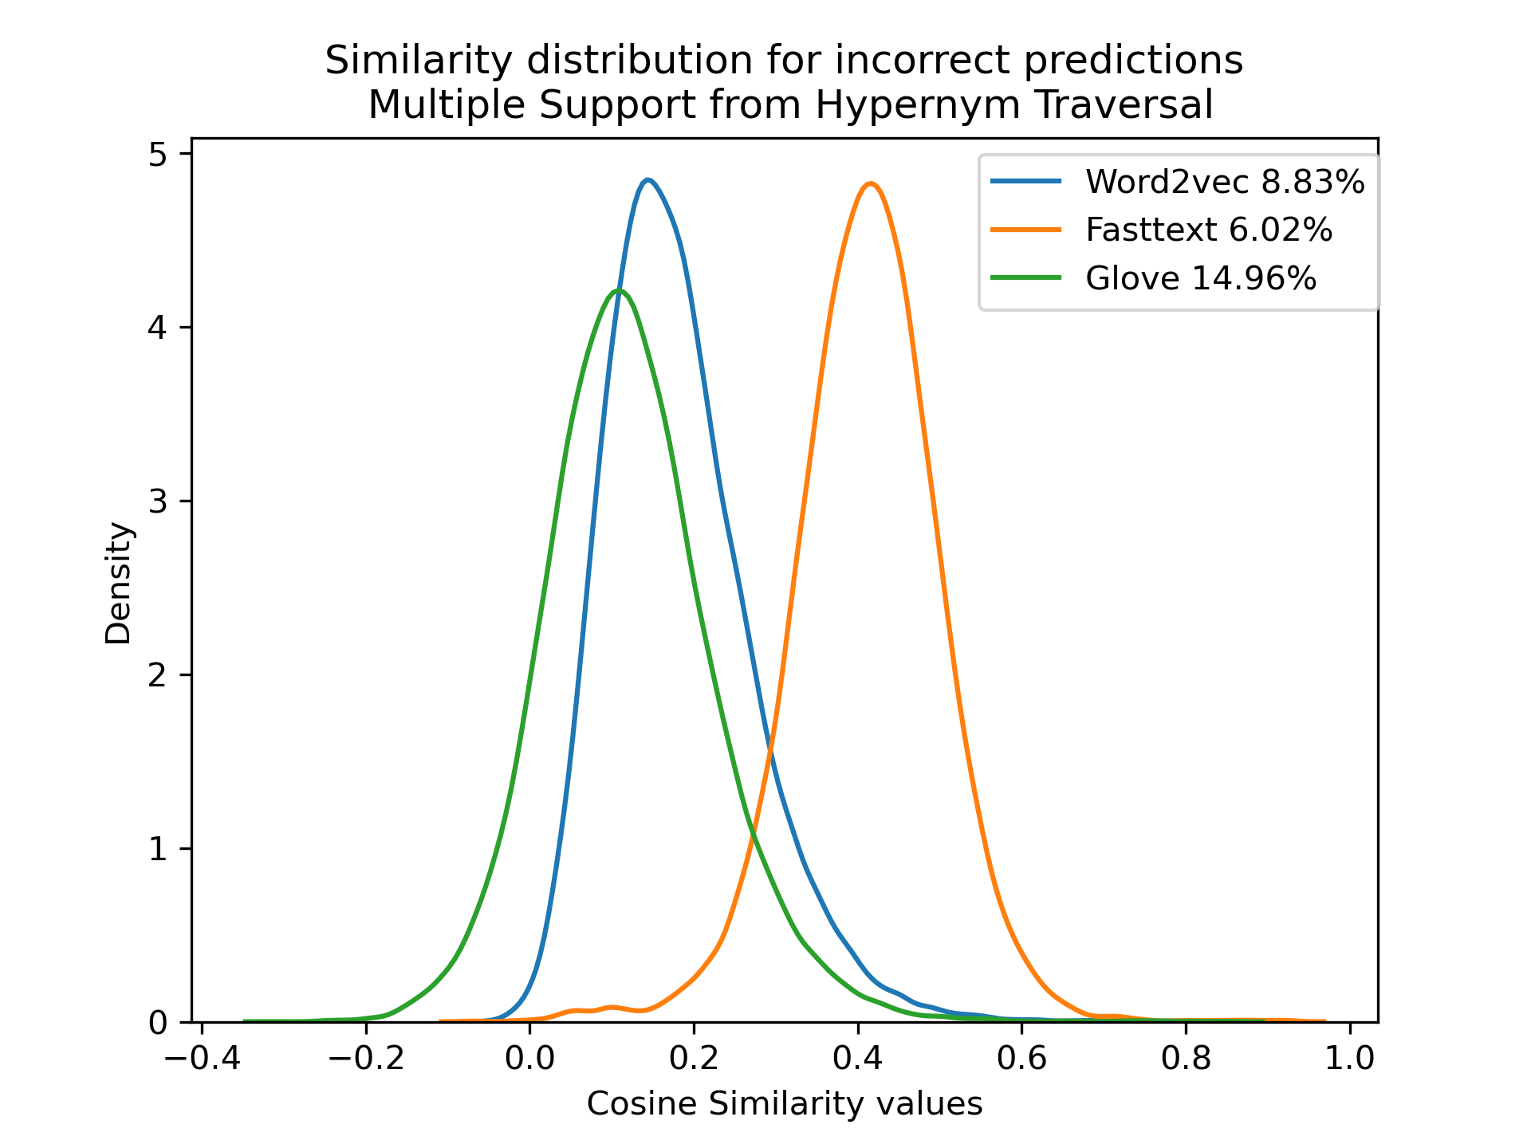
Multiple Support(X) and Single True Query(Y) for Hypernym Traversal.
Hypernym Traversal
RESULTS ANALYSIS
Notes:
Density plot = frequency plot

Slide 22
Gaussian Distribution for Correct Predictions on Term Lists from direct synset
Analysis
Dataset prepared only from synset directly | Single Support Mean and Standard Deviation(SD) | Multiple Support Mean and Standard Deviation(SD)
Word2Vec | Mean = 0.38 SD = 0.19 | Mean = 0.39 SD = 0.18
fastText | Mean = 0.55 SD = 0.15 | Mean = 0.55 SD = 0.13
Glove | Mean = 0.27 SD = 0.18 | Mean = 0.26 SD = 0.16
RESULTS ANALYSIS

Slide 23
Gaussian Distribution for Incorrect Predictions on Term Lists from direct synset
Analysis
Dataset prepared only from synset directly | Single Support Mean and Standard Deviation(SD) | Multiple Support Mean and Standard Deviation(SD)
Word2Vec | Mean = 0.15 SD = 0.09 | Mean = 0.18 SD = 0.09
fastText | Mean = 0.33 SD = 0.11 | Mean = 0.39 SD = 0.10
Glove | Mean = 0.11 SD = 0.099 | Mean = 0.11 SD = 0.094
RESULTS ANALYSIS

Slide 24
Gaussian Distribution for Correct predictions on Term Lists from Hypernym Traversal
Analysis
Dataset prepared from Hypernym Traversal on WordNet | Single Support Mean and Standard Deviation(SD) | Multiple Support Mean and Standard Deviation(SD)
Word2Vec | Mean = 0.30 SD = 0.16 | Mean = 0.36 SD = 0.16
fastText | Mean = 0.46 SD = 0.12 | Mean = 0.55 SD = 0.12
Glove | Mean = 0.21 SD = 0.15 | Mean = 0.27 SD = 0.15
RESULTS ANALYSIS

Slide 25
Gaussian Distribution for Incorrect Predictions on Term Lists from Hypernym Traversal
Analysis
Dataset prepared from Hypernym Traversal on WordNet | Single Support Mean and Standard Deviation(SD) | Multiple Support Mean and Standard Deviation(SD)
Word2Vec | Mean = 0.15 SD = 0.09 | Mean = 0.18 SD = 0.09
fastText | Mean = 0.36 SD = 0.09 | Mean = 0.41 SD = 0.09
Glove | Mean = 0.10 SD = 0.094 | Mean = 0.12 SD = 0.10
RESULTS ANALYSIS

Slide 26
Three things we observe:
Observation
Multiple support makes similarity scores higher. This can be observed from shift in the Gaussian curve towards right from single support to multiple support. (For finding broader relations, it is helpful to have more words).
2. FastText performed better, but most of space in fastText is sparse[4], because the gaussian distribution has higher mean for this model for both correct and incorrect predictions. Hence, fastText model learns word-vectors positioned at high density area of space. Notice, however the difference among two means is as significant as other models.
3. Hypernym relations have lower mean and this was expected as they share lesser similarity than facet terms of direct synset.
Notes:
Multiple support have better benefits to hypernym relations

Slide 27
Can we get better?
Observation
We observe that state of the art word-embeddings model provides great performance in recognizing Facet Terms against random words with high accuracy. However, when we look closer, the similarity distribution has significantly lesser mean.
Are Cup and Coffee associated or similar words? Does association imply similarity[4]? We need to draw a stricter boundary in word-embeddings space among similar and associated words.
The best performing model is not good enough for the task of facet Term recommendation. A good model for this task, would have mean centered around close to 1 and a very small standard deviation. If we can obtain, this model the algorithmic support of word-embeddings could be extended for the tasks of facets generation.

Slide 28
Idea of relative Co-occurrence
Relative Co-occurrence
I eat apples after working out.
The relative position of eat with respect to apples is one before it.
Anything that can be substituted for apples also belongs to the same Facet - the eatable category.
To draw that stricter boundary among associated and similar words, between substitutional similarity and distributional similarity. If two words X and Y generate the same positional context during training, then X and Y should have similar encoding in the word-vector representation.

Slide 29
Idea of relative Co-occurrence
Relative Co-occurrence
I eat apples after working out.
oranges
Bases on this idea, of relative co-occurrence, we plan to train a Skip Gram word-embeddings model, based on premise that similar words would generate similar positional context and as a consequence of this, will have higher similarity scores than associated words.
X
Y
W_{i-2}, W_{i-1}, W_{i+1}, W_{i+2}
And such a word-embedding model, we believe would be suitable for Facet Term Recommendation Tasks.

Slide 30
05 Developing Embeddings Model for Facet Generation Tasks
We shall develop two Skip Gram Models - Classic and Modified. The Modified Skip gram architecture shall accommodate positional context into training and is based on premise that similar words shall generate similar positional context.
We shall train the two models on similar criteria to eliminate any unfair advantage of one model over another. The criterias are:
Negative Sampling
Equal number of Epochs (50)

Slide 31
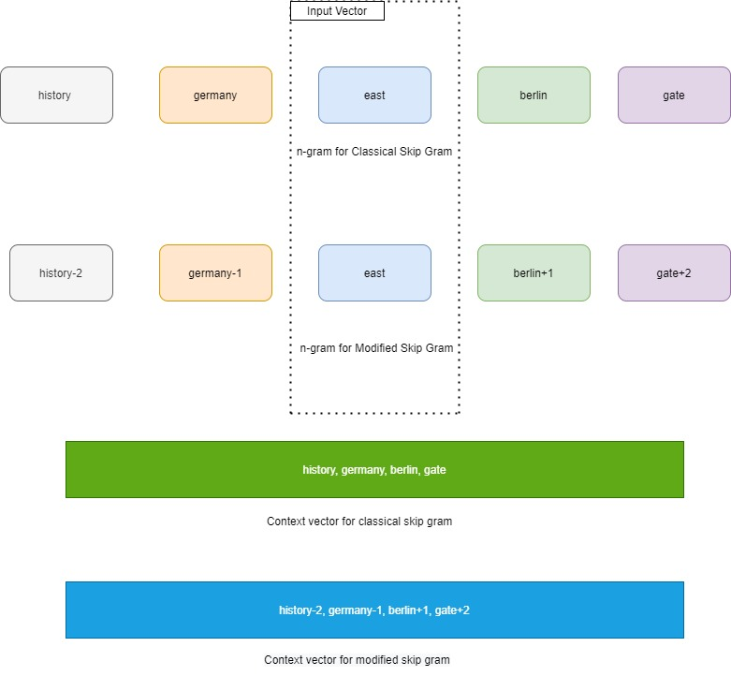
Modified Skip Gram Architecture
Modified Skip Gram
In the Modified Skip Gram Architecture, we take the positional co-occurrence in to the account.

Slide 32
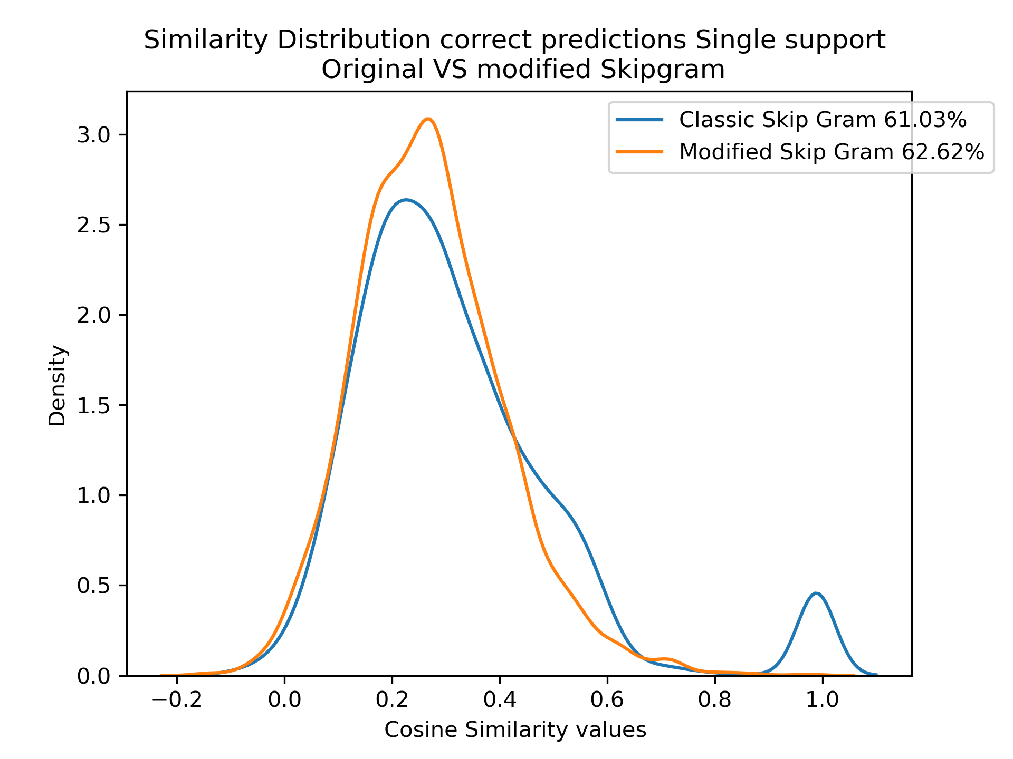
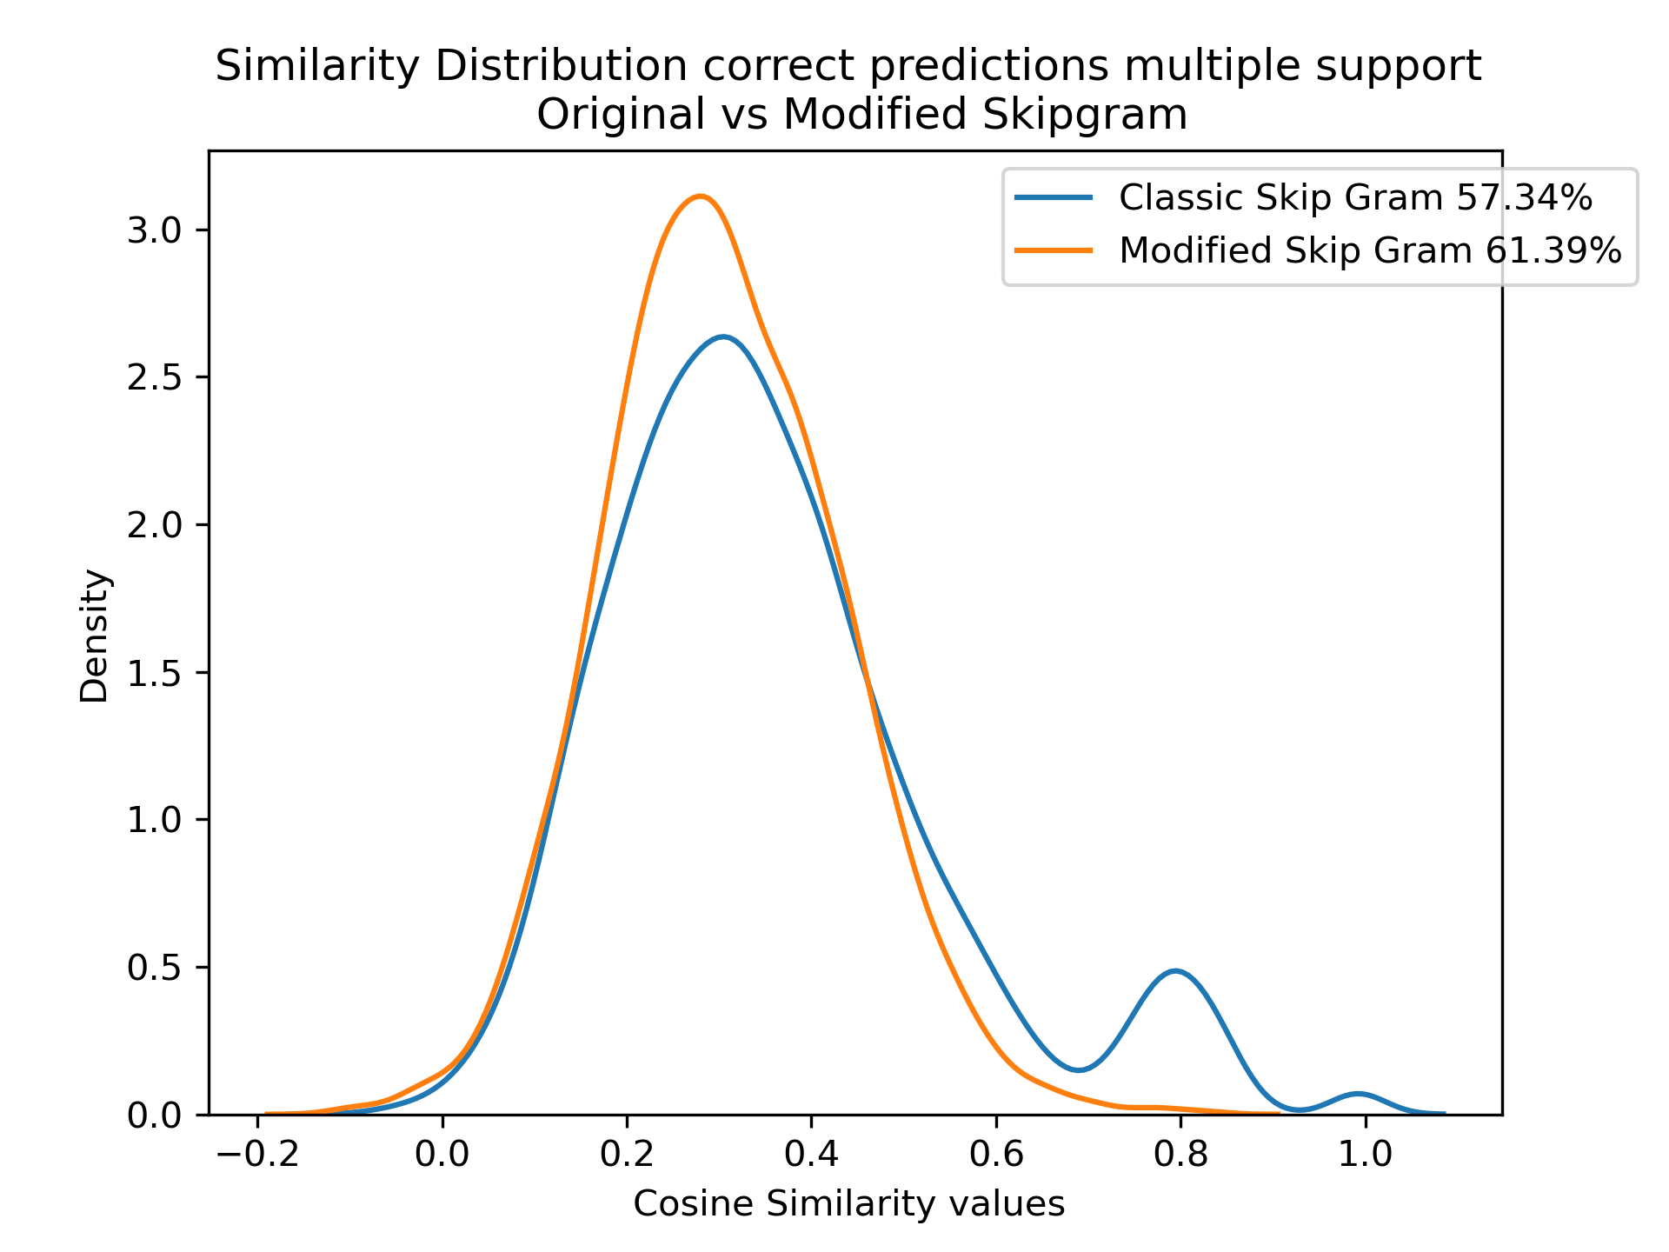
Similarity Distribution of Correct Predictions on Term Lists from Direct Synset
Analysis

Slide 33
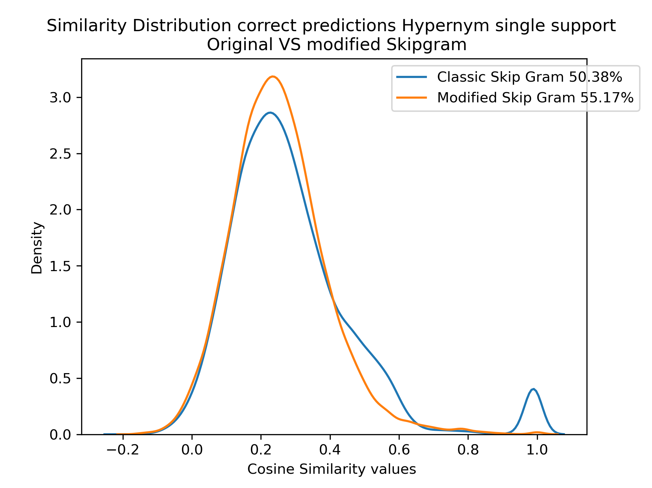
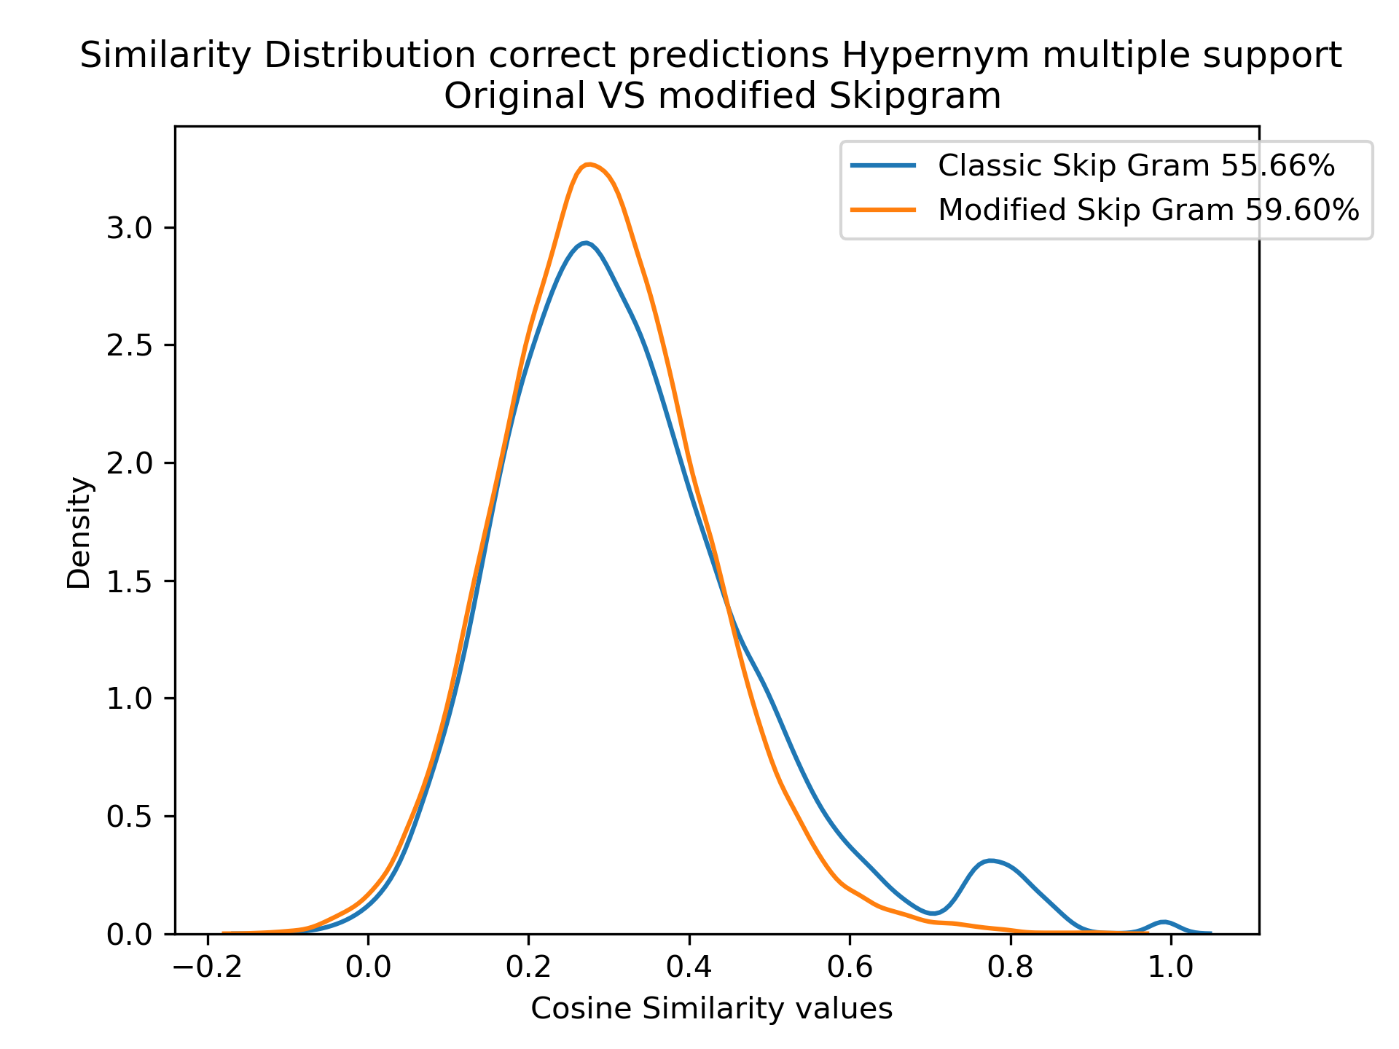
Similarity Distribution of Correct Predictions on Term Lists from Hypernym Relations
Analysis

Slide 34
Summary of Correct Predictions
Analysis
Dataset prepared only from synset directly | Single Support Mean and Standard Deviation(SD) | Multiple Support Mean and Standard Deviation(SD)
Classic Skip Gram | Mean = 0.31 SD = 0.19 | Mean = 0.35 SD = 0.17
Modified Skip Gram | Mean = 0.27 SD = 0.13 | Mean = 0.30 SD = 0.12
Dataset prepared from Hypernym Traversal on WordNet | Single Support Mean and Standard Deviation(SD) | Multiple Support Mean and Standard Deviation(SD)
Classic Skip Gram | Mean = 0.28 SD = 0.18 | Mean = 0.32 SD = 0.16
Modified Skip Gram | Mean = 0.25 SD = 0.13 | Mean = 0.30 SD = 0.12
RESULTS ANALYSIS

Slide 35
Summary of Incorrect Predictions
Analysis
Dataset prepared only from synset directly | Single Support Mean and Standard Deviation(SD) | Multiple Support Mean and Standard Deviation(SD)
Classic Skip Gram | Mean = 0.30 SD = 0.21 | Mean = 0.30 SD = 0.19
Modified Skip Gram | Mean = 0.23 SD = 0.11 | Mean = 0.28 SD = 0.11
Dataset prepared from Hypernym Traversal on WordNet | Single Support Mean and Standard Deviation(SD) | Multiple Support Mean and Standard Deviation(SD)
Classic Skip Gram | Mean = 0.27 SD = 0.21 | Mean = 0.30 SD = 0.18
Modified Skip Gram | Mean = 0.23 SD = 0.12 | Mean = 0.27 SD = 0.11
RESULTS ANALYSIS

Slide 36
06 Conclusion
The standard Deviation decreases across both correct and incorrect predictions, pointing out that Modified skip gram brings all the words to high density of space and is unable to draw a stricter boundary between similar and associated words.
2. The parameter space for word-embeddings for modified skip-gram is 4 times more than for the classic skip-gram and hence, it might need more training to give some efficient results.
The poor performance could be because of time-constraints(50 epochs), or we need way more data or perhaps something we are missing in our consideration.
Notes:
Need way more data Or are we missing something in our consideration

Slide 37
Future Works
Future
Works
The conversions of semantic networks into semantic spaces has gained momentum recently and the word-embeddings models so obtained have performed substantially better than word-embeddings models trained on large collections of texts for semantic similarity tasks. Node Embeddings node2Vec to encode existing lexical graph structures through graph embedding Techniques[3].
2. We should dig further in drawing a stricter boundary between associated and similar words in Word-Embeddings models and other such efforts like substitutional similarity vs distributional similarity should be made in architectures for word-embeddings models.

Slide 38
Thank you for your attention!

Slide 39
References
[1] Feddoul, L., Schindler, S., & Löffler, F. (2019, September). Automatic Facet Generation and Selection over Knowledge Graphs. In International Conference on Semantic Systems (pp. 310-325). Springer, Cham.
[2] Tzitzikas, Y., Manolis, N., & Papadakos, P. (2017). Faceted exploration of RDF/S datasets: a survey. Journal of Intelligent Information Systems, 48(2), 329-364.
[3] Levy, O., Goldberg, Y., & Dagan, I. (2015). Improving distributional similarity with lessons learned from word embeddings.
[4] Elekes, Á., Schäler, M., & Böhm, K. (2017, June). On the various semantics of similarity in word embedding models. In 2017 ACM/IEEE Joint Conference on Digital Libraries (JCDL) (pp. 1-10). IEEE. [Abstract], 1, 2.4, 4.5
[5] Medelyan, O., Witten, I. H., Divoli, A., & Broekstra, J. (2013). Automatic construction of lexicons, taxonomies, ontologies, and other knowledge structures. Wiley Interdisciplinary Reviews: Data Mining and Knowledge Discovery, 3(4), 257-279. [Pre-requisites], 2, 3.5, 3.5.2

